Slide 1
Rabin-Karp String Matching
Henry Chen, Amogh Ghadge, Yuyan Wang
Notes:
Yuyan

Slide 2
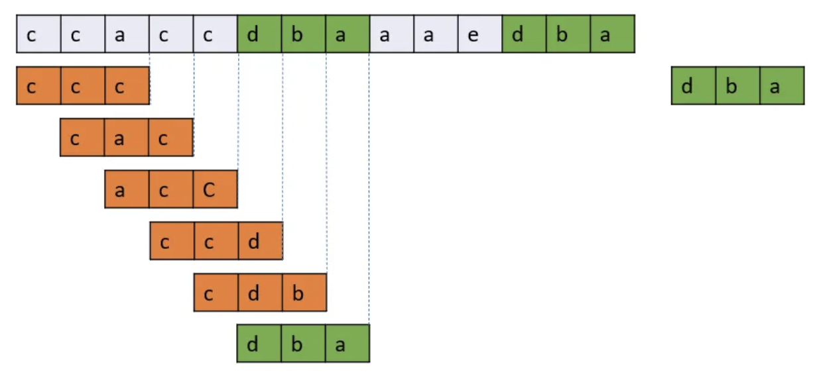
String Matching
Problem: Find all occurrences of pattern in the text and return all indices they start at
Naive Approach: Run through the String and check every possible substring.
Runtime: O(n*m) where the size of the string is n and the size of the pattern is m.
Notes:
Yuyan

Slide 3
Goal
Can we make the runtime faster than O(n*m)? Can we do on average O(n+m)?
Notes:
Yuyan

Slide 4
Rabin-Karp String Matching Algorithm
What does Rabin-Karp do?
Hashes substrings by encoding characters in accordance with their order.
Computes hashes of new windows fast by utilizing the last hash value.
Variables:
T → the Text that we are going to find the pattern
d → number of possible characters in string space
q → a large prime number
S → substring with length m
U→ unicode of all characters
Notes:
Amogh

Slide 5

Hash Function
Where:
S is the substring with length m
uS[i] is the Unicode of character at S[i]
d is the base
q is to prevent overflow
Unicode of “a” = (ord(“a”) - ord(“a”) + 1) = 1
Unicode of “c” = (ord(“c”) - ord(“a”)+ 1) = 3
m = 3, q = 101
s1 = “acc”
hash(s1) = (1 * 26^2 + 3 * 26^1 + 3 * 26^0) mod 101 = 50
s2 = “cac”
hash(s1) = (3 * 26^2 + 1 * 26^1 + 3 * 26^0) mod 101 = 37
set to a large prime number to avoid collisions
Notes:
Yuyan

Slide 6
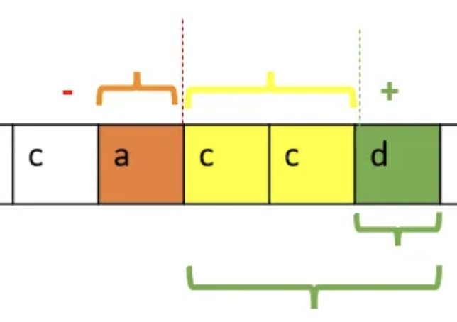

Rolling Hash
Where:
hash is the hash value of substring
d is the base
u is the Unicode of all possible char
h is the highest order coefficient
q is a large prime
Hash of “acc” is
Unicode of “d” = (ord(“d”) - ord(“a”)+ 1) = 4
d = 26; h = 26 ^ (3-1)
Substring is represented by a three digit base 26 number
q = 101
New Hash = (26 * (50 - 1 * 26 ^ 2) + 4) mod 101 = 90
Notes:
Henry

Slide 7
Code Implementation
# find all indices in the text that match the pattern
def rabin_karp(text, pattern):
indices, base, q, target_hash, curr_hash, l = [], 26, 101, 0, 0, 0
high_order = pow(base, len(pattern), q)
# Compute the hash of the pattern
for i in range(len(pattern)):
target_hash = (target_hash * base + (ord(pattern[i]) - ord('a') + 1)) % q
# Sliding window
for r in range(len(text)):
curr_hash = (curr_hash * base + (ord(text[r]) - ord('a') + 1)) % q
# Rolling hash update
if r - l + 1 > len(pattern):
curr_hash = (curr_hash - (ord(text[l]) - ord('a') + 1) * high_order) % q
l += 1
# Check if the current window matches the pattern
if r - l + 1 == len(pattern) and curr_hash == target_hash:
if text[l:r+1] == pattern:
indices.append(l)
return indices
Notes:
Amogh

Slide 8
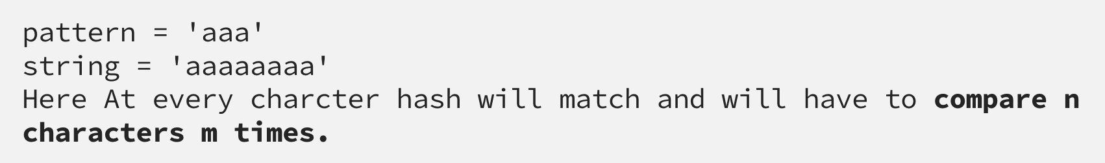
Time Complexity
Complexity:
Spurious hits are when the hash value of the pattern matches with the hash value of a window but the content of the window is not equal to the pattern
Occurs as a result of modding by q
Require manual check when hashes equal
The average case and best case complexity of Rabin-Karp algorithm is O(m + n) and the worst case complexity is O(mn).
Worst case occurs when pattern matches every window in the text
Notes:
Henry

